Slide 1
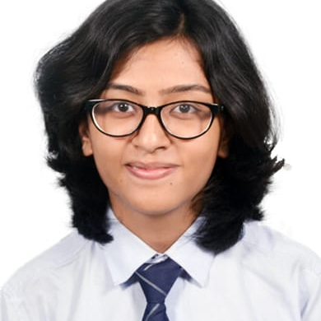



Jagyaseni Sengupta
Analyst/Software Engineer
Bachelor of Engineering
Computer Science : 2017 - 2021
Skills
Java 8 /J2EE | Java Basics, OOPS, Collections, Arrays, Loops, Lambda Exp, Stream API,Junit, Mockito,
Spring core | IOC & Dependency Injection, SpringBoot Annotations
Spring REST | REST controllers, Implementation of GET, POST, PUT & DELETE, Testing Services, Controller & Repository layer
Spring Data JPA | Implement DAO layer using spring Data repositories
Spring Boot Microservices | Spring Boot Starters, annotations, Messaging Service, Swagger API documents
Spring Cloud | Eureka, Netflix Hystrix, Netflix Zuul & Config Server
React | Components, Hooks, Event handling
Database | MongoDB No Sql Basics, Postgre SQL
UI Tech | HTML 5 & CSS 3,JavaScript, ES6.
Tools | Git, Postman, Eclipse IDE
Add On skills | Communications, Team management. Peer learning
Mumbai
xxxxxxxxxxx@capgemini.com
+91 7980600366
A4
Full Stack Developer
Hands on experience in creating microservices with Springboot, Jwt Authentication, Role Based Authorization , Spring Security , Spring Cloud API Gateway, Eureka Server.
Hands on experience in developing web pages using HTML5, CSS3, Object Oriented Java script, ES6. Good understanding of Document Object Model (DOM).
Hands on experience in building, creating documentation and testing RESTful APIs with Swagger and unit testing using Junit, Mockito.
Implemented the polyglot architecture with ReactJs & SpringBoot in case study, and upskilling knowledge continuously.
Implemented MongoDB and RabibitMq in the case study.
Online Railway Reservation System
Completed end to end case study of Online Railway Reservation Application along with JWT authentication, Swagger and made a, responsive UI with Html, CSS and ES6 concepts and ReactJs used for user interface.
Library Management System
Completed end to end case study of Online Library Management System along with MonolithiC Architecture. Database used is Postgre SQL and using React, HTML, Css for Ui Interface.
Completed “HTML and Css For Web Developers“ course at Coursera
Check out my work on GitHub & Video Profile

